Slide 1
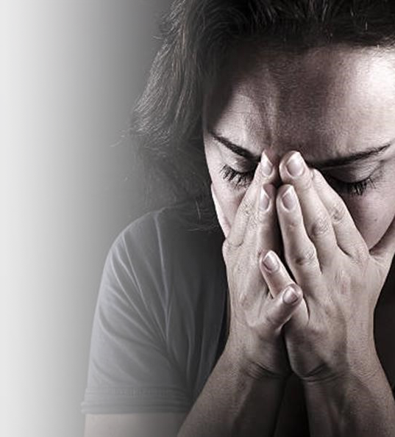


THE DAMAGE BEHIND THE BRUISES
Isabelle Benson-Clarke, Benjamin Breslov, Amitai Erfanian, Zoe Goodman, and Theodore Winter
Notes:
Welcome
Our presentation is on the effect of blunt trauma on soft tissue
Specifically, we are tackling the internal damage caused by interpersonal violence,
Or, The damage behind the bruises

Slide 2
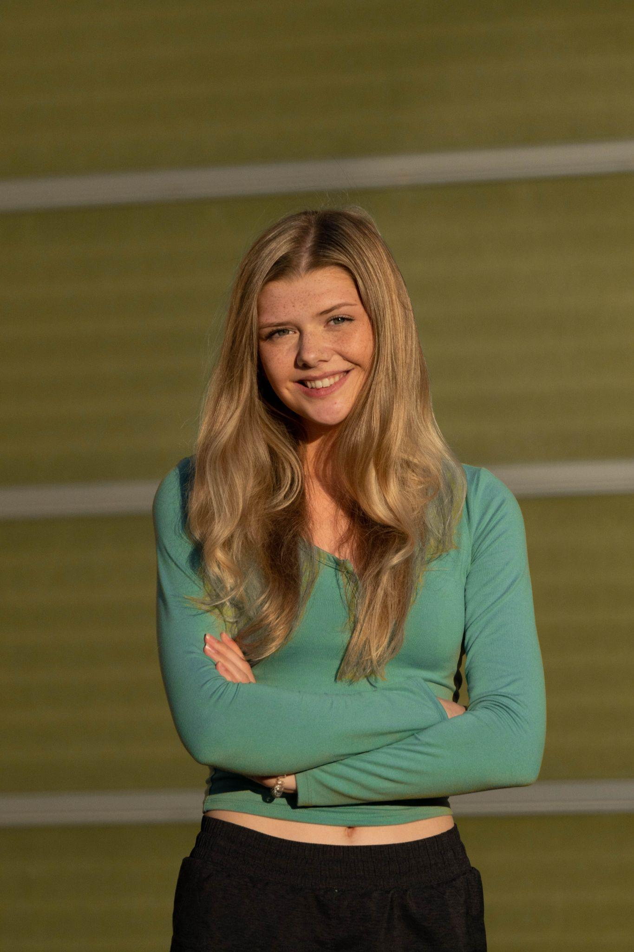
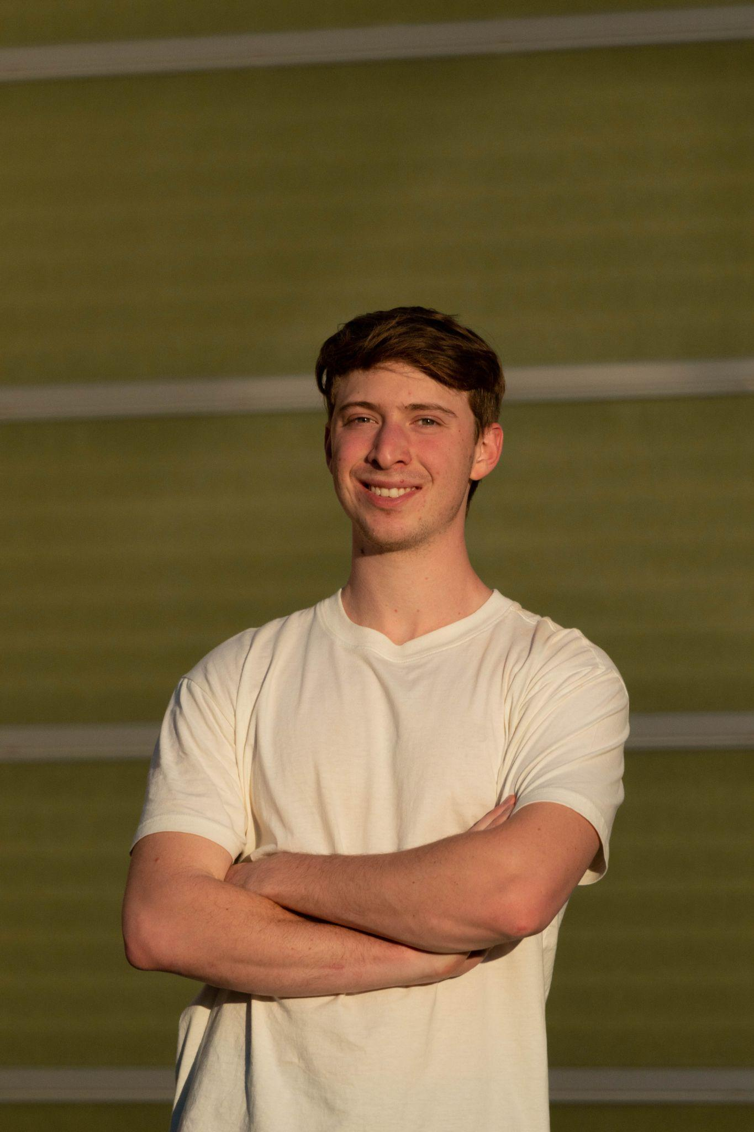
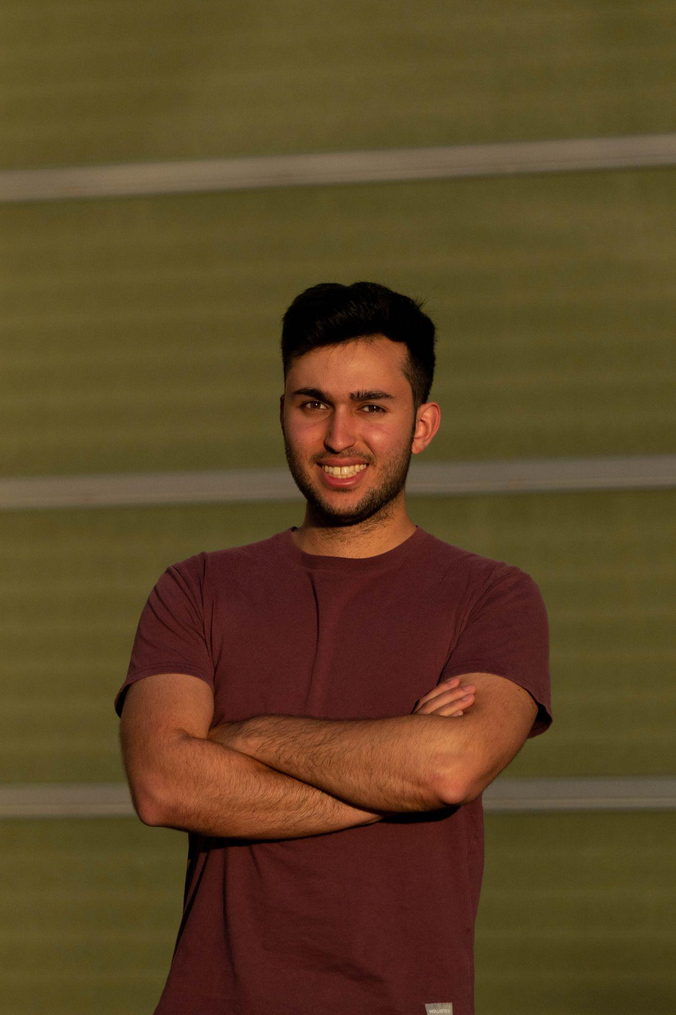
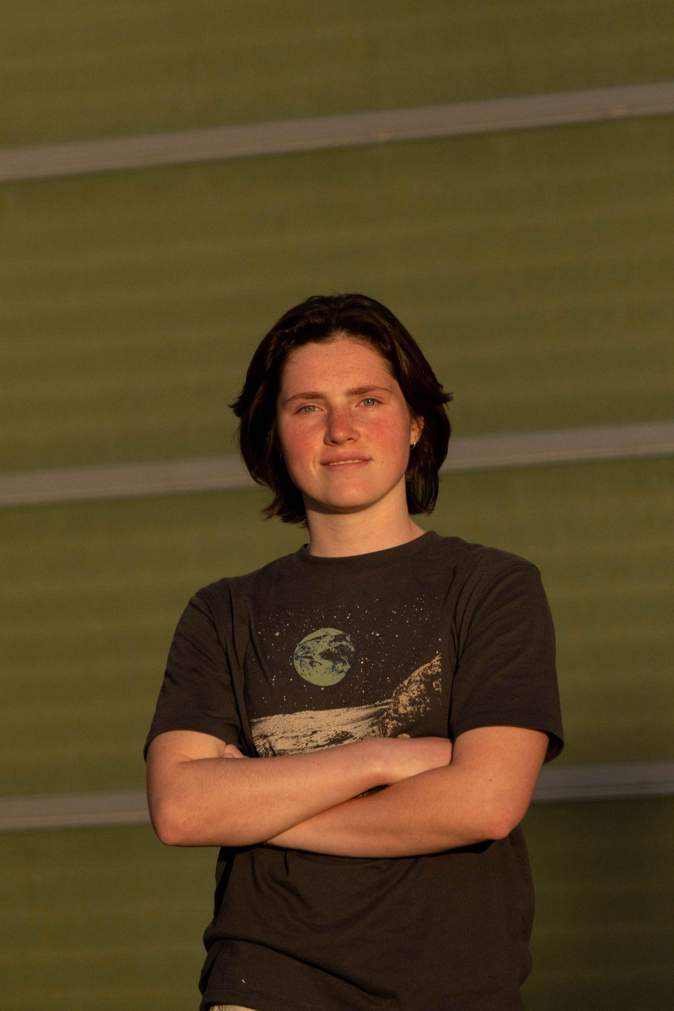
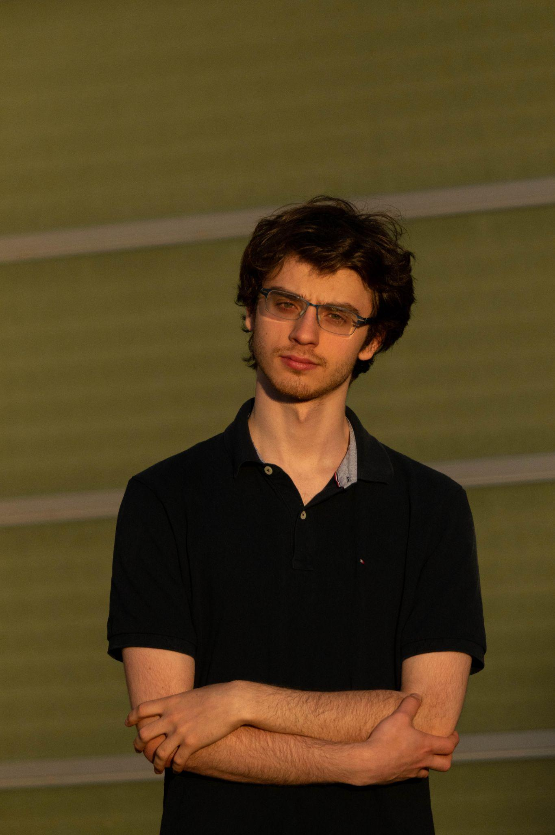
WPI Team Members
Isabelle Benson-Clarke
Benjamin Breslov
Amitai Erfanian
Zoe Goodman
Theodore Winter

Slide 3
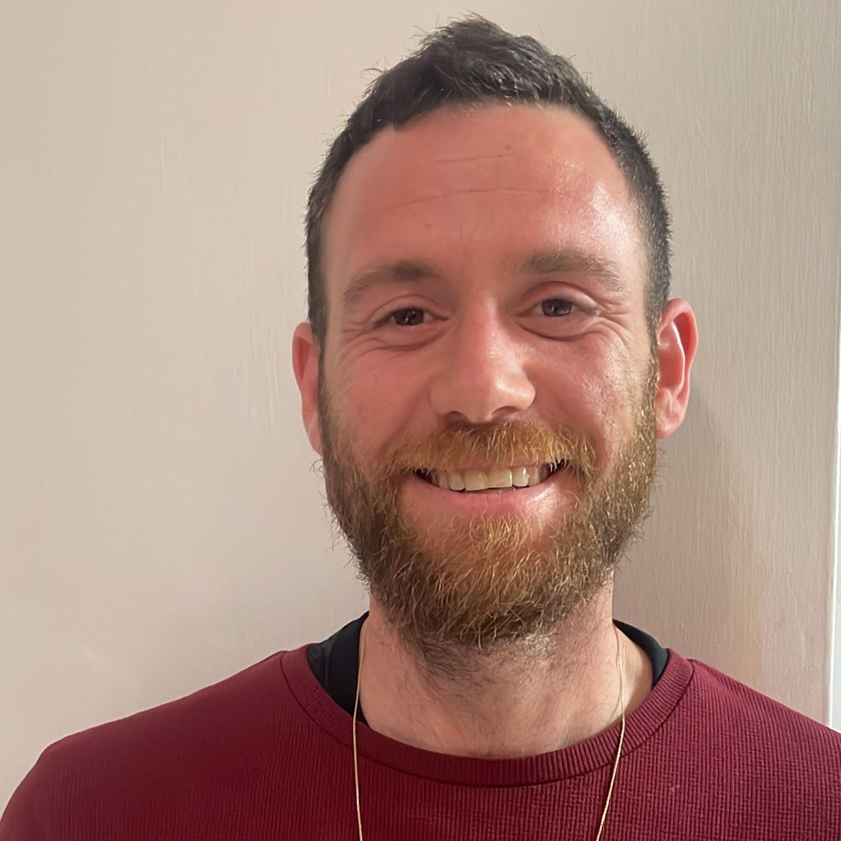
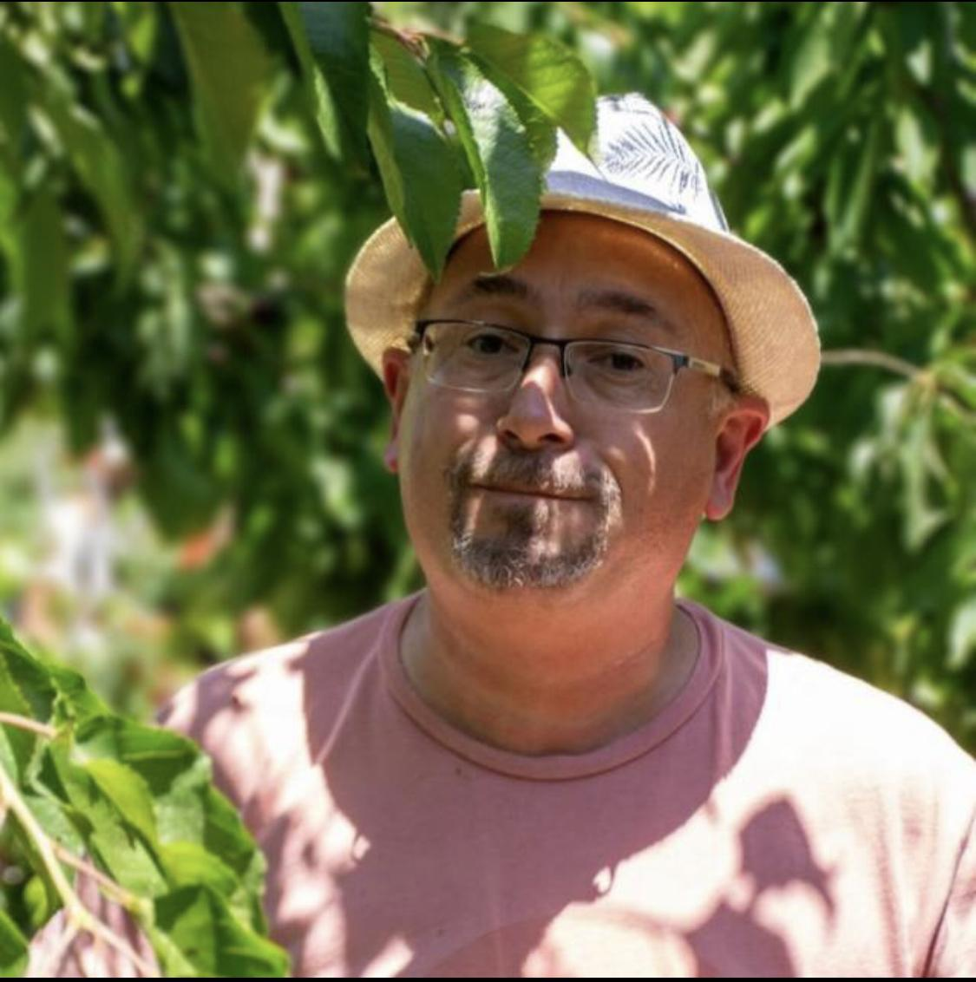
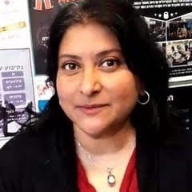
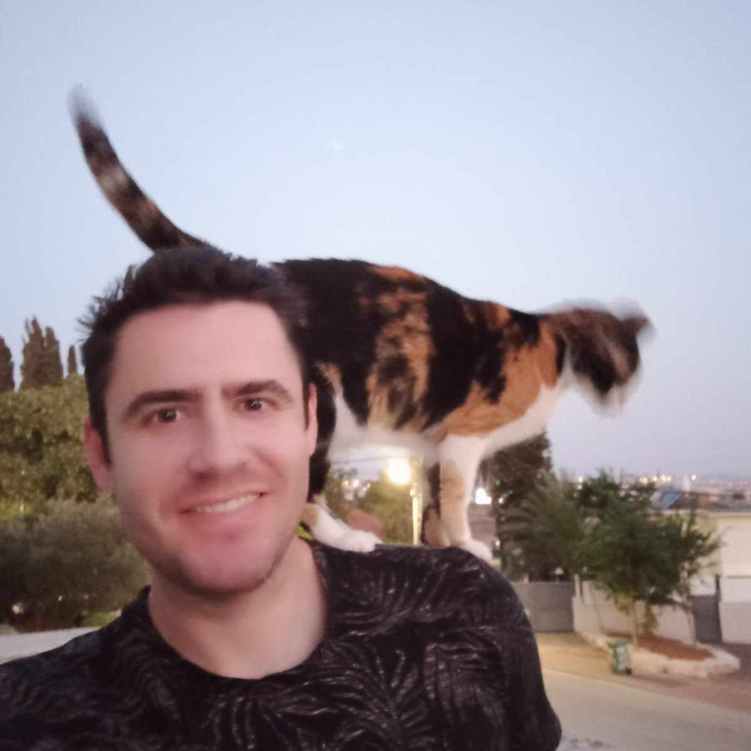
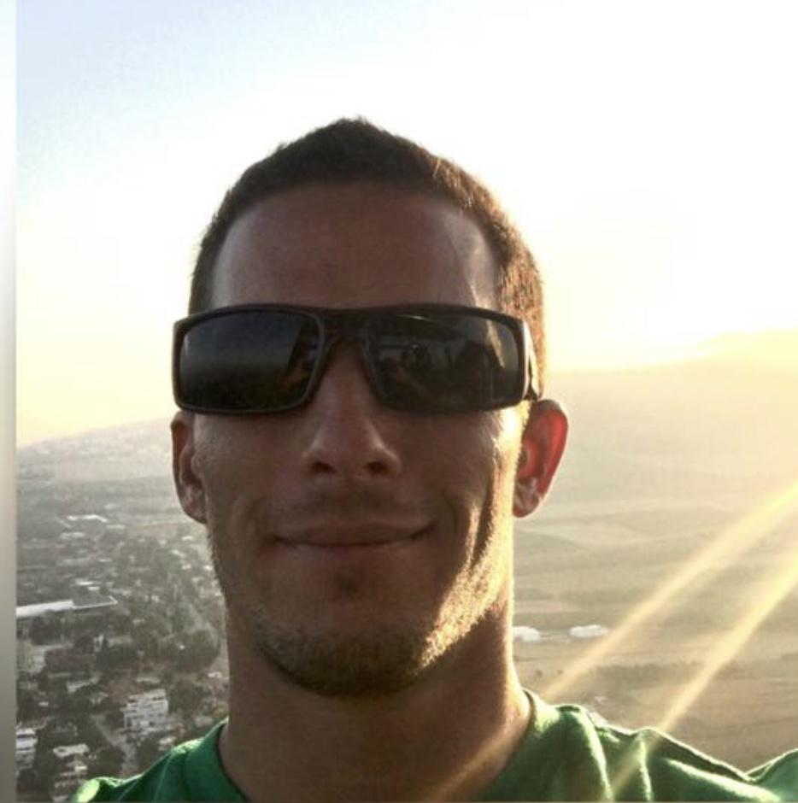
Israeli Team Members
Nadav Torgueman
Daniel Wasserman
Dr. Seema Biswas
Gil Paikin
Atar Perach
Notes:
It has been incredible to be able to work with a Public Health Expert and surgeon, Dr. Seema Biswas who is now treating victims of the Israeli-Palistinean Conflict. As a surgeon and a professor in the mechanical engineering department of the Braude College of engineering, she has focused her efforts on the global health crisis that is domestic violence.
We also worked with students from the university Nadav, Gil and Atar. Nadav and Daniel helped make this project possible.

Slide 4
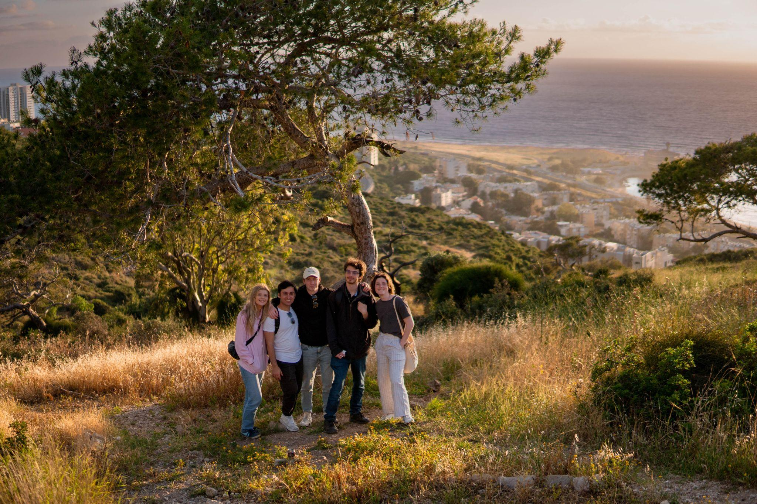
A huge thank you to Braude College for hosting us!
Notes:
Throughout the course of this project we worked with the Braude College of Engineering in Israel. We were originally the Moscow, Russia project center and transitioned to 4 weeks in Karmiel, Israel due to aggression in Ukraine

Slide 5
01
Global Health: Problem Statement
Increase in cases of domestic violence since 2019
Notes:
IZZY
Imagine you are a social worker or a doctor, you see a women or child covered in bruises, but they are unable to articulate how they got them. Its almost pointless to ask, you know how this happened, domestic violence. But without the tools to confront the abused and the abuser with the reality of the situation, how can you stop this from happening again? When abusers and the abused are both unaccepting of the realities of domestic abuse, how can we stop the cycle of violence.

Slide 6
45%
of women either have been or know of someone who has experienced violence since COVID-19
Notes:
IZZY
Domestic Violence is a global problem
Covid-19 pandemic has exacerbated this problem due to social isolation

Slide 7
Domestic Violence: A Global Problem
30%
50%
44%
suffer blunt trauma
increase in cases
cases go unreported
Notes:
IZZY
World-wide, domestic violence rates have increased by 30% since 2019
Domestic Violence is a taboo subject,
44% of Cases go unreported
50% of these victims suffer blunt trauma
Which is an impact to the body that does not break skin

Slide 8
3 out of 5 batterers reoffend within 10 years
Currently, there are no proven methods of reducing reoffence
Notes:
IZZY
This problem is perpetuated by a lack of effective intervention programs
3 out of 5 of batterers reoffend within 10 years of completing a batterer intervention program
Many batterers don’t even complete the full program

Slide 9
02
Project Goal
Notes:
THEO
We created demonstrative tool to be used as part of a batterer intervention program. Our goal was to create a procedure that can be used to combat the recent increase of instances of interpersonal violence and address the shortcomings of current batterer intervention programs and blunt trauma models.

Slide 10
How can we confront abusers with the reality of their actions?
Notes:
Image of remorseful abuser? Image of a woman or child?

Slide 11
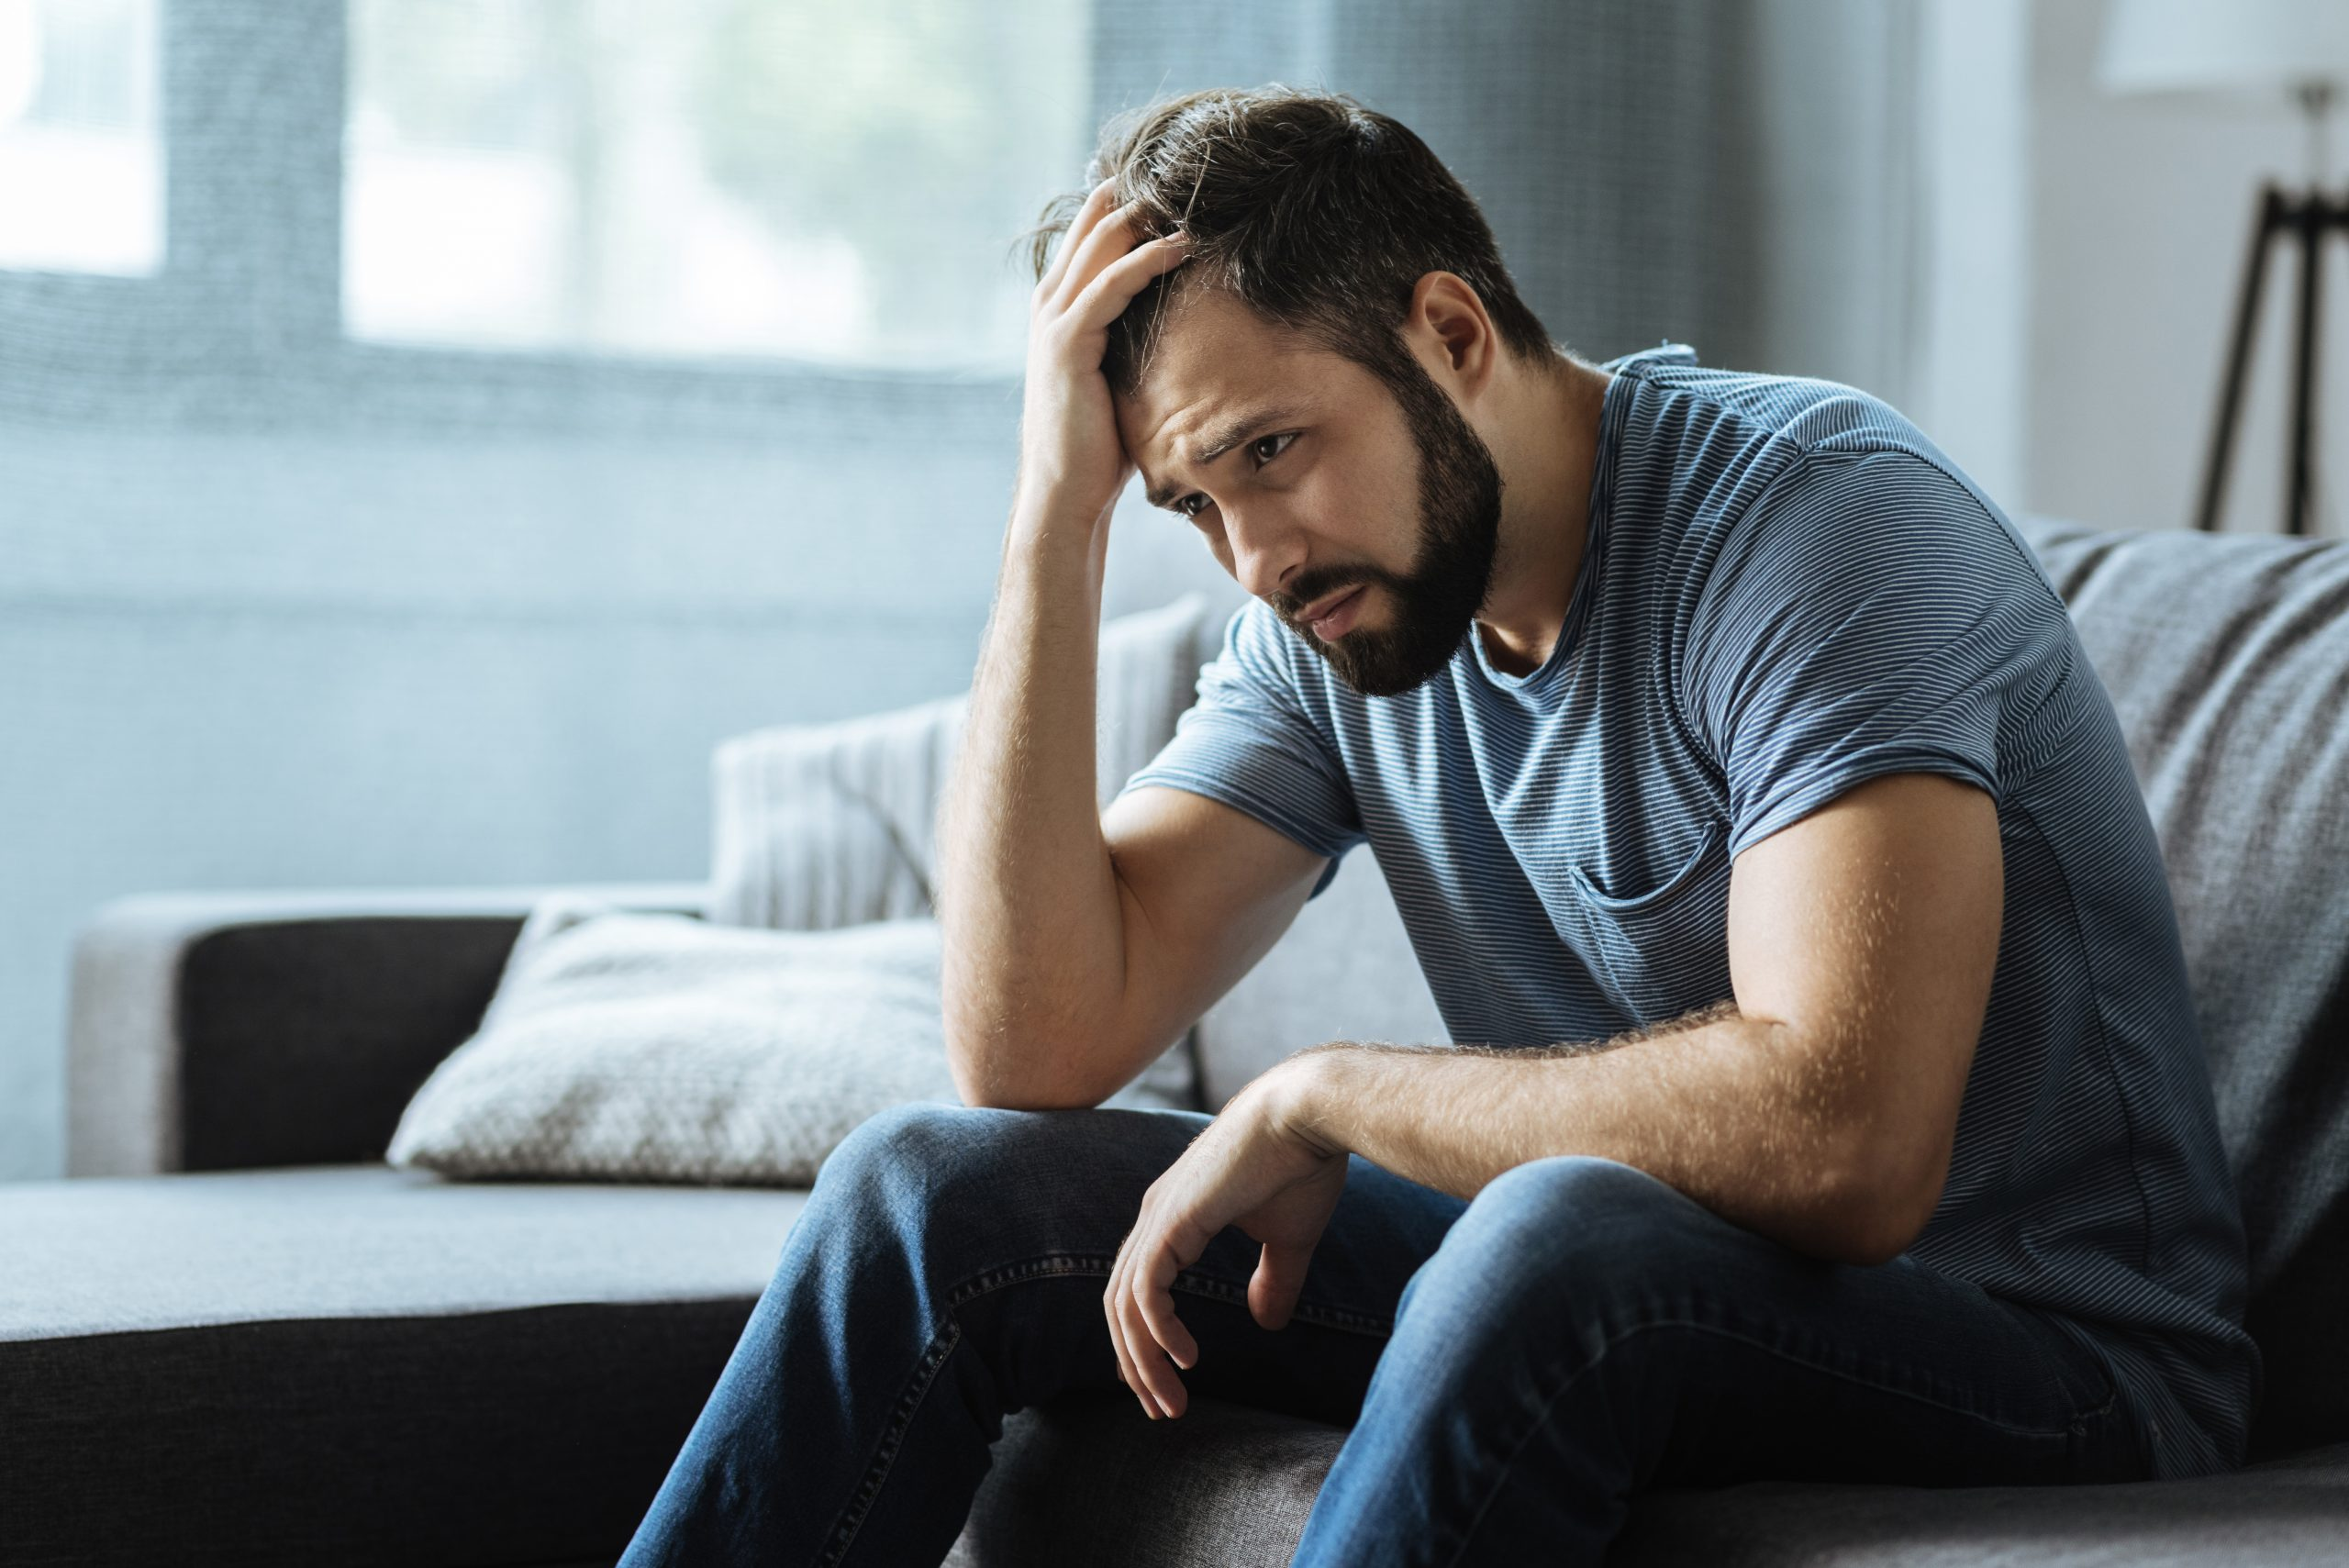
Anthropological studies show demonstrative methods are highly effective in inducing behavioral change

Slide 12
Create a demonstrative tool to
increase awareness and reduce violence

Slide 13
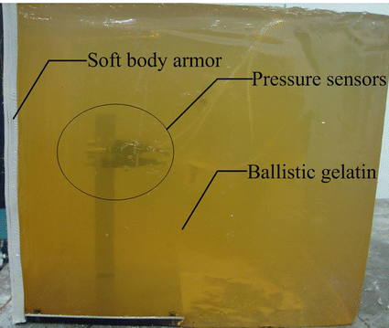
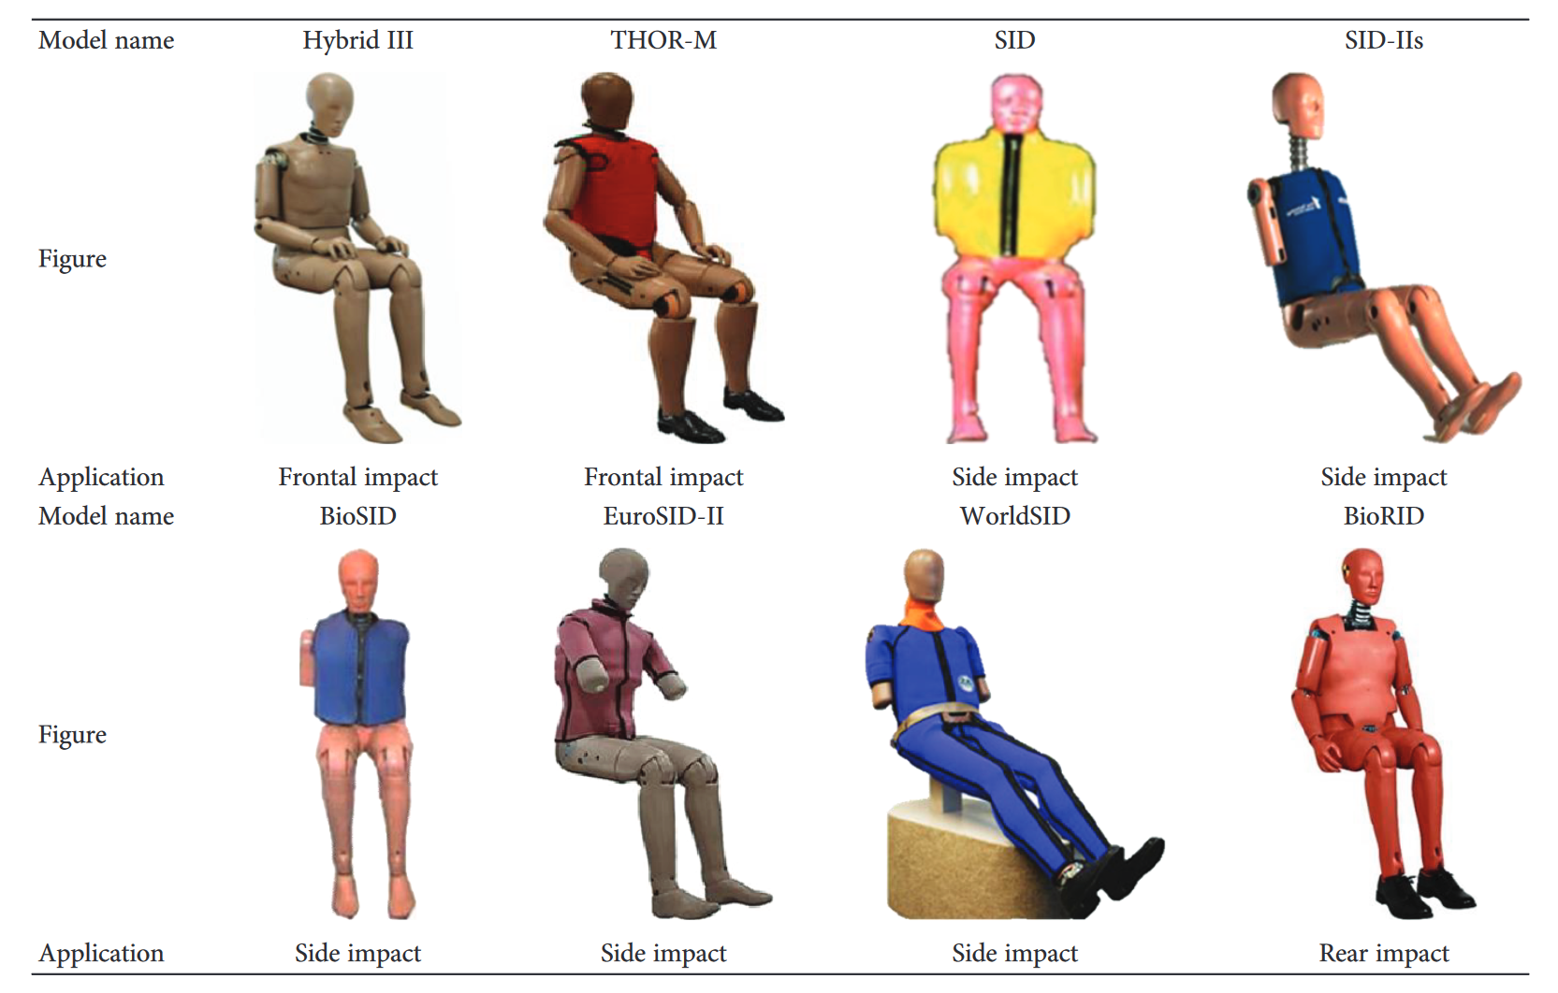
Existing Models
Notes:
THEO
Current methods of reducing domestic violence rates have proven ineffective.
Existing blunt trauma models do not realistically show the internal damage caused.
They cannot simulate swelling or bruising
Demonstrative models must have this realistic component

Slide 14
Project Objectives
Create a durable model of a human thigh
Create a sensor and software system to display visual feedback
Create a qualitative procedure to assess model efficacy
Notes:
THEO
Create a durable model thigh, capable of withstanding heavy impacts and displaying visual feedback to the user.
Create a sensor and software system to measure how hard the model was hit. Integrate it with a software display and the model's visual feedback.
Create a qualitative procedure to assess the effectiveness of the model as a demonstrative tool.

Slide 15
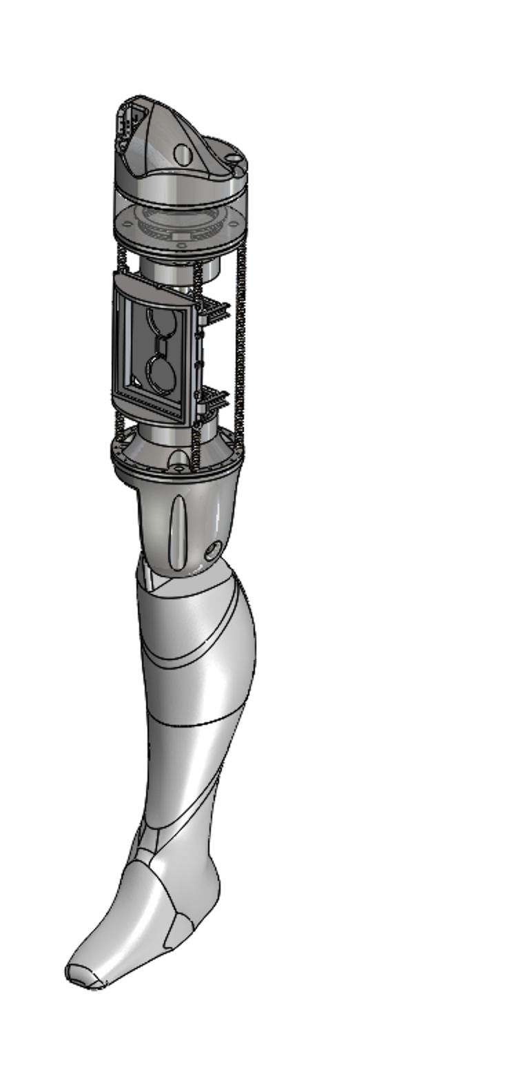
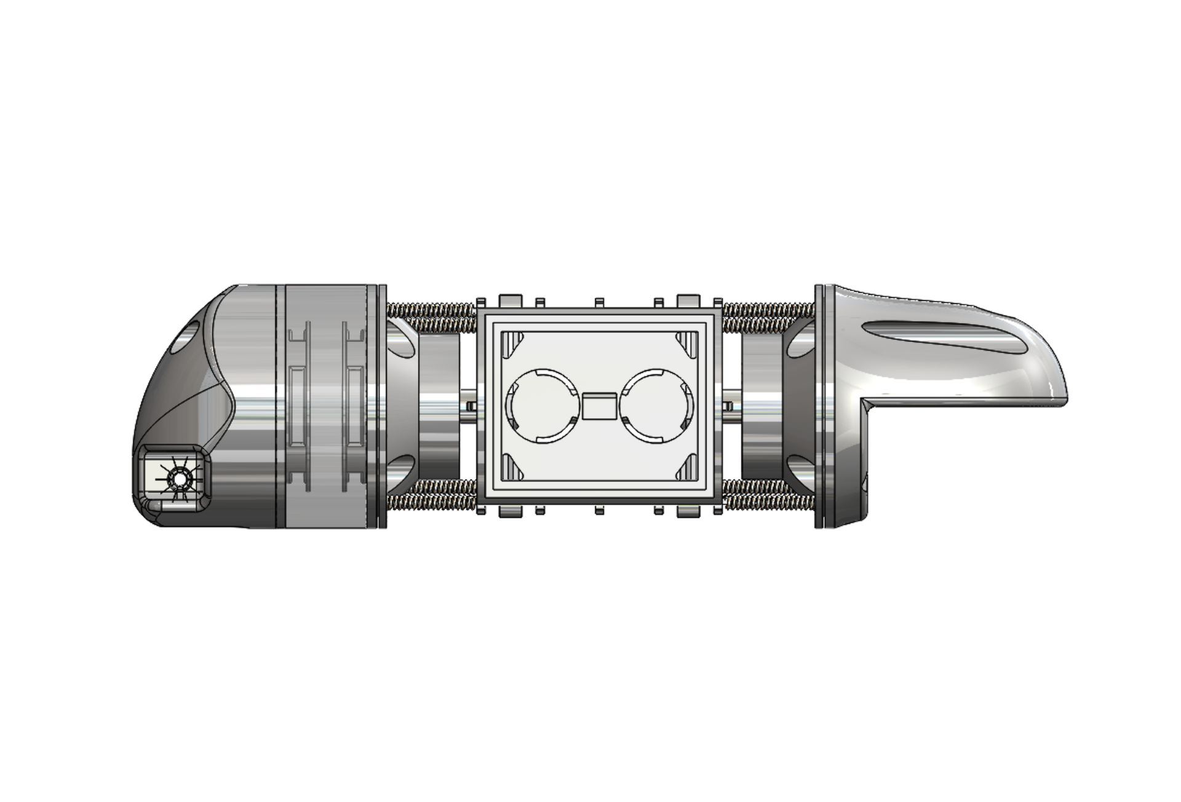
The Model
Notes:
BEN
In order to tackle this problem, we built this leg
This is what it does!
Allows users to strike the model and see the real force of impact
Talk about how bruising isn't always immediately apparent

Slide 16
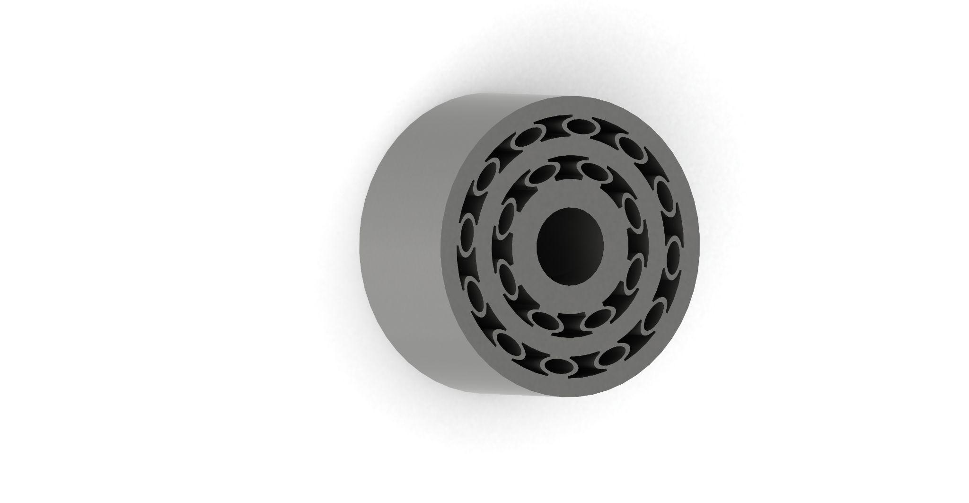
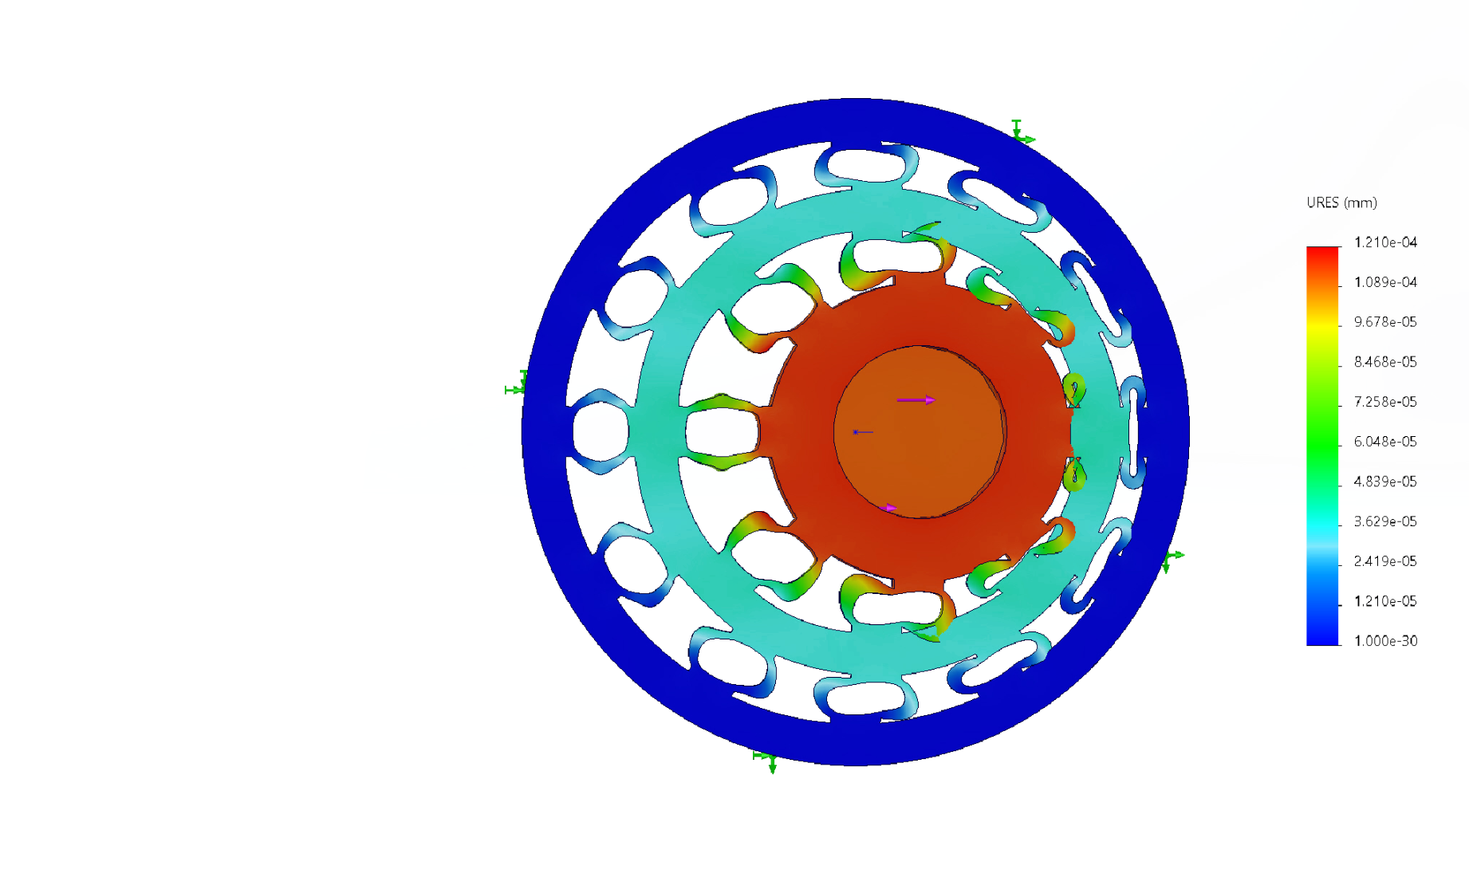
The Model - Shock Absorber
Notes:
BEN
In order to tackle this problem, we built this leg
This is what it does!
Allows users to strike the model and see the real force of impact
Talk about how bruising isn't always immediately apparent

Slide 17
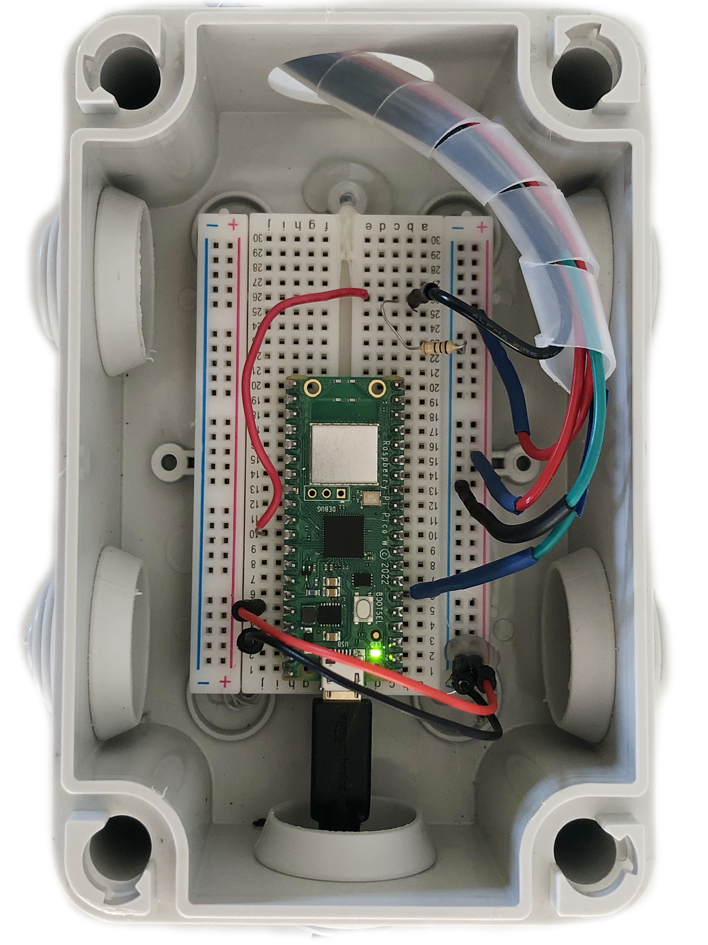
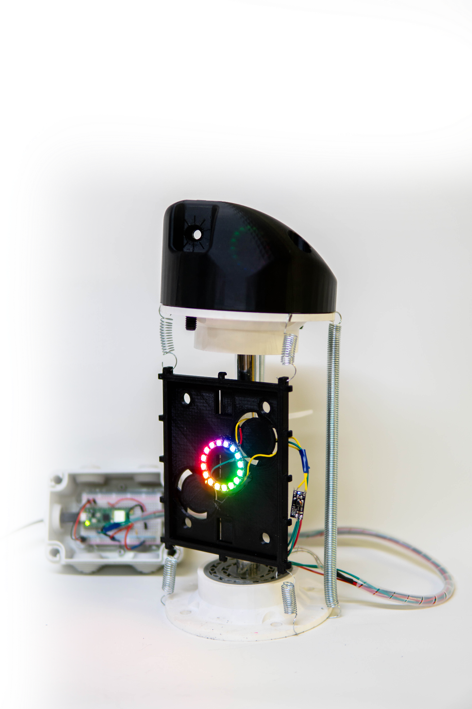
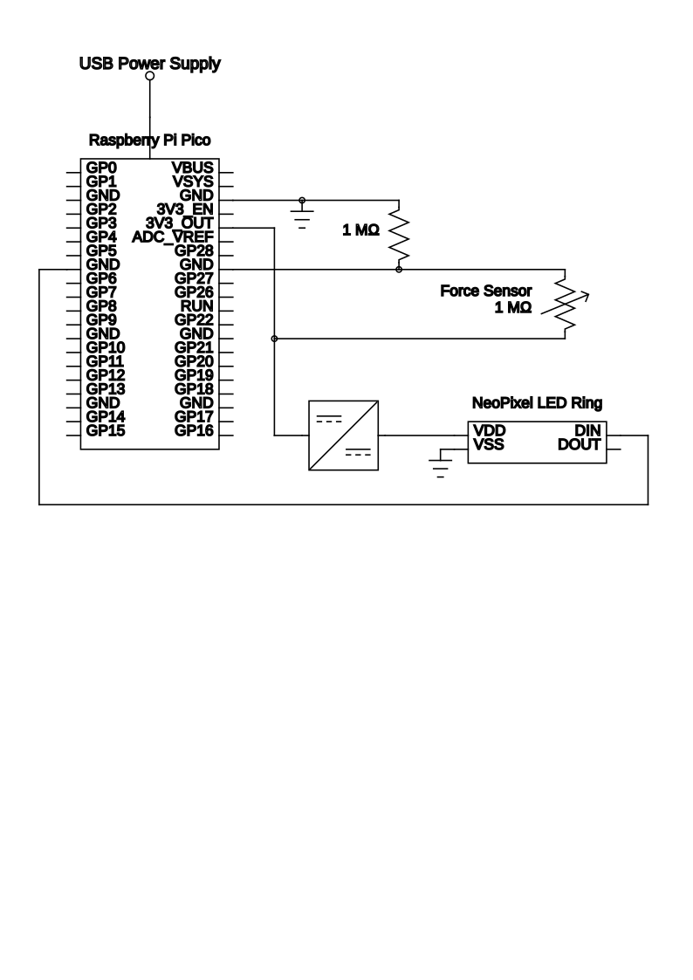
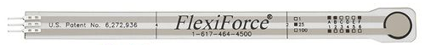
Electronics
Notes:
ZOE
Electrical Components
This is what is on the inside
(show slide of internal components)
Force sensitive resistors that measure the force in newtons
Raspberry pi

Slide 18
Model Version 2
Used linear potentiometers for increased accuracy
Improved 3D printed springs
Upgraded feedback mechanism
Notes:
Material constraints within our 4 week time limit in Israel imposed limitations on our model. Once we got back to the US we made improvements and forwarded them to our sponsor

Slide 19
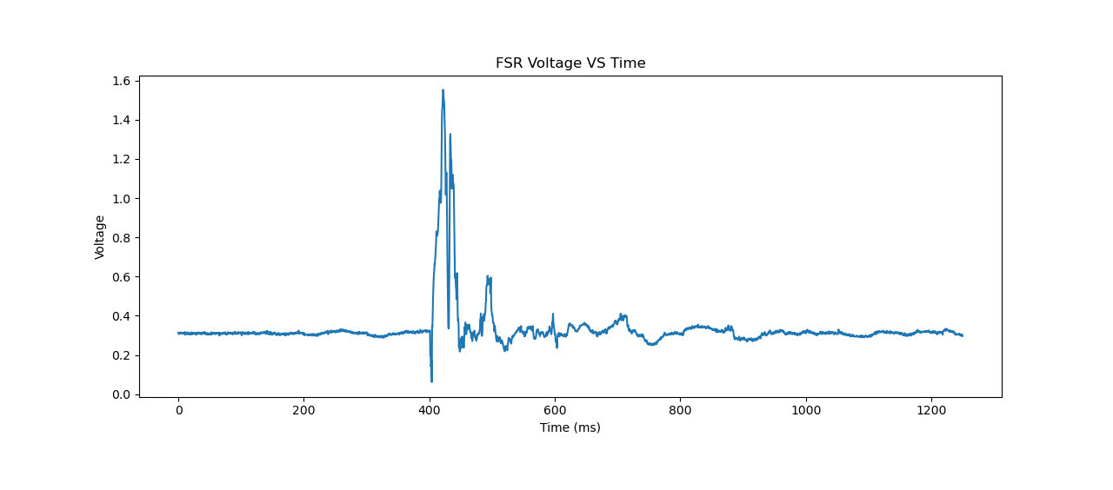
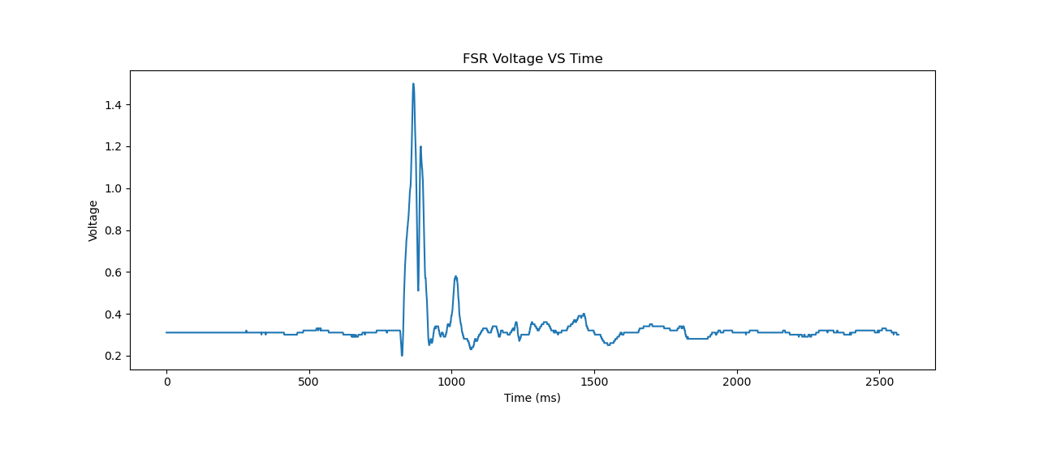
Sensor Noise Reduction
Notes:
IZZY
Despite our sensor improvements, there was still signal noise.
For both the force sensor and the linear potentiometer we applied an averaging filter
This smoothed our overall data to create a main, large peak that can be detected instead of a jagged line with many little peaks

Slide 20
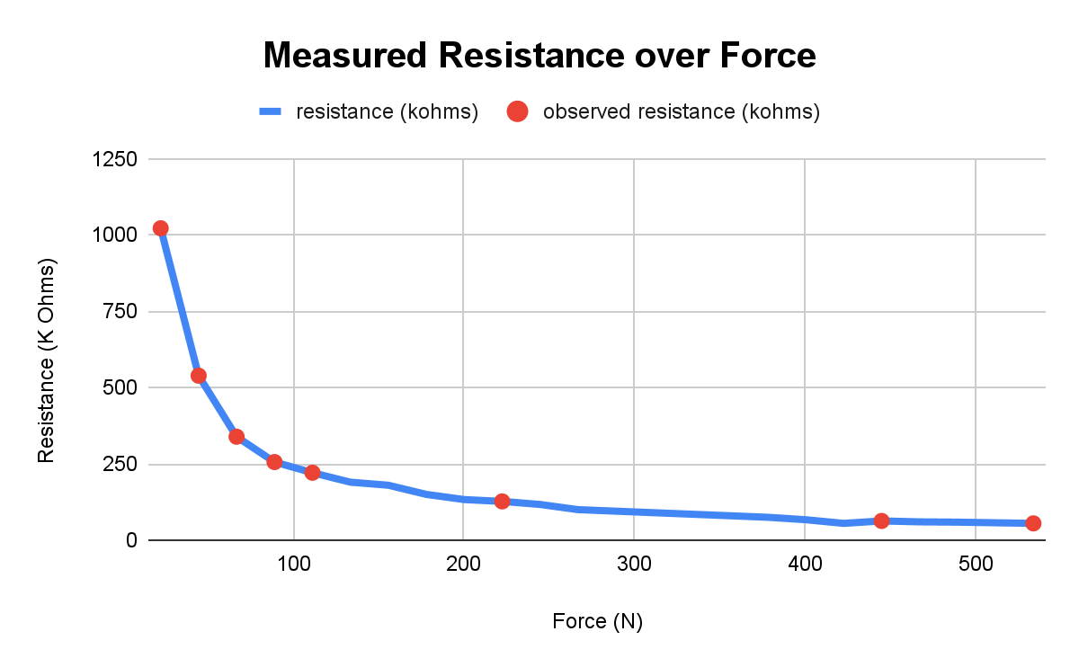
Sensor Data Interpretation
Notes:
ZOE

Slide 21
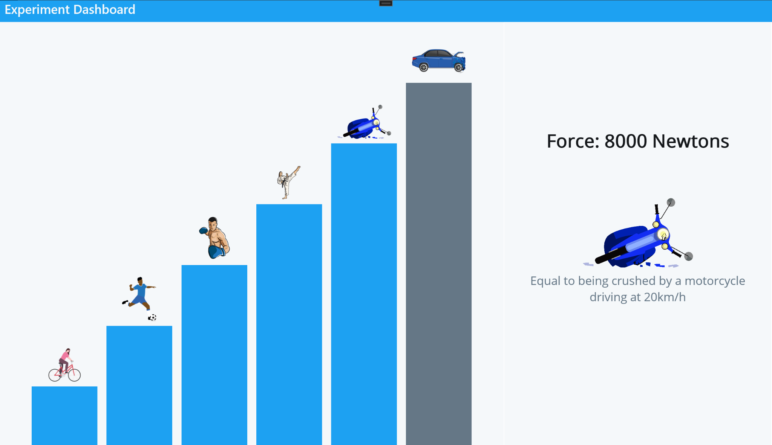
Severity of Impact on Tissue
Computer Software Experimental Dashboard
Notes:
Equates the force to a more relatable event

Slide 22

Notes:
The demonstration of our model is a sensitive subject, and may trigger emotional reactions. Viewer discretion is advised.

Slide 23
Live Demo
Notes:
Back to Dr Office
Bruising on Woman
Husband says not that hard
What tools to show consequences of actions
Invite audience member
This damage is not usually shown (bruises are not that obvious)

Slide 24
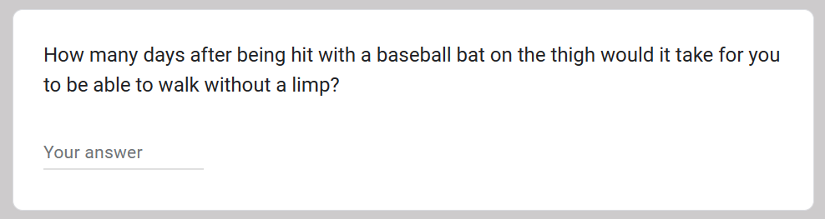
Questionnaire
Notes:
Instructions for social worker to use model
Abuser to reflect on actions
Ask question to judges (correct answer is “on the order of Weeks”)

Slide 25
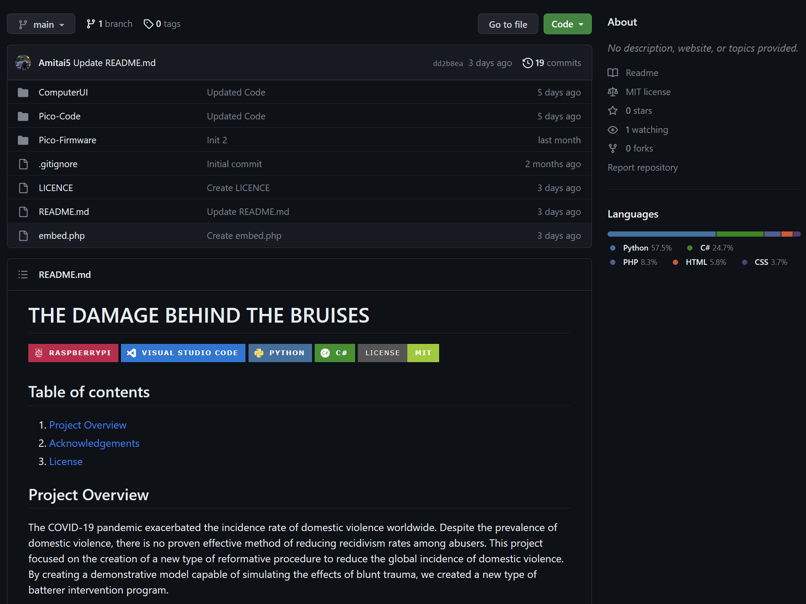

Spreading the Word
Notes:
All of code is available on GitHub for anyone else to access
Also will have SolidWorks files, code, the paper, and instructions on how to build another model

Slide 26
03
Conclusion
Notes:
The goal of this project was to make abusers realize the damage they do beneath the skin and understand the magnitude of force they are using
We want to cause a change in behavior as people confront the reality of their own strength and make them think twice before they hit someone again

Slide 27
Thanks!
Do you have any questions?

